Slide 1
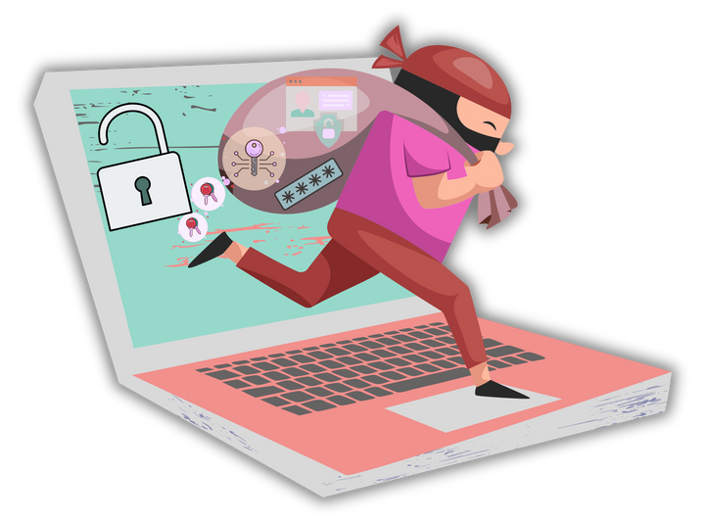
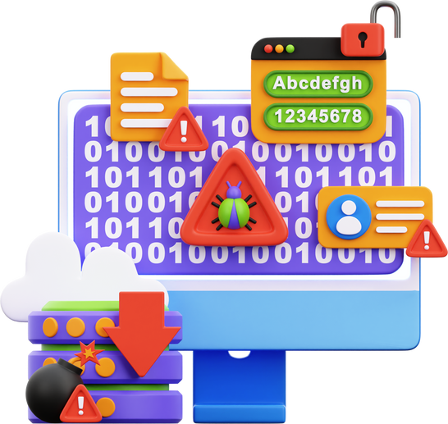



Zero Phish
AI‑Powered Phishing Detection

Slide 2

PROBLEM STATEMENT
Frontline supply‑chain employees (procurement officers, warehouse staff, admin) interact daily with unknown external emails, chats, invoices and lack formal cybersecurity training.
Consequences include:
Financial fraud and data breaches
Loss of reputation and erosion of customer trust
Industry stats:
68% of companies experience cyberattacks
29% of those stem from vendor‑targeted phishing

Slide 3

OUR SOLUTION
A Generative‑AI assistant tailored to non‑technical supply‑chain roles.

Slide 4

KEY FEATURES
Help non-technical users identify malicious content.
Support text and file.
Detect and explain the type of threat (phishing, spam, etc.).
Provide risk score (0–100% confidence).
Offer role-specific advice and awareness tips.
Voice output (gTTS) for accessibility
Downloadable, timestamped security reports for record‑keeping

Slide 5

TECH STACK
LLaMA (Groq): Fast inference + contextual explanations.
BERT: Pretrained phishing detection model.
Gradio: Interactive frontend hosted on Hugging Face Spaces.
PyMuPDF: PDF parsing for invoice/document text extraction.
gTTS: Converts flagged explanations into speech.
Hugging Face Spaces: End-to-end scalable deployment.

Slide 6
SYSTEM DIAGRAM

Slide 7
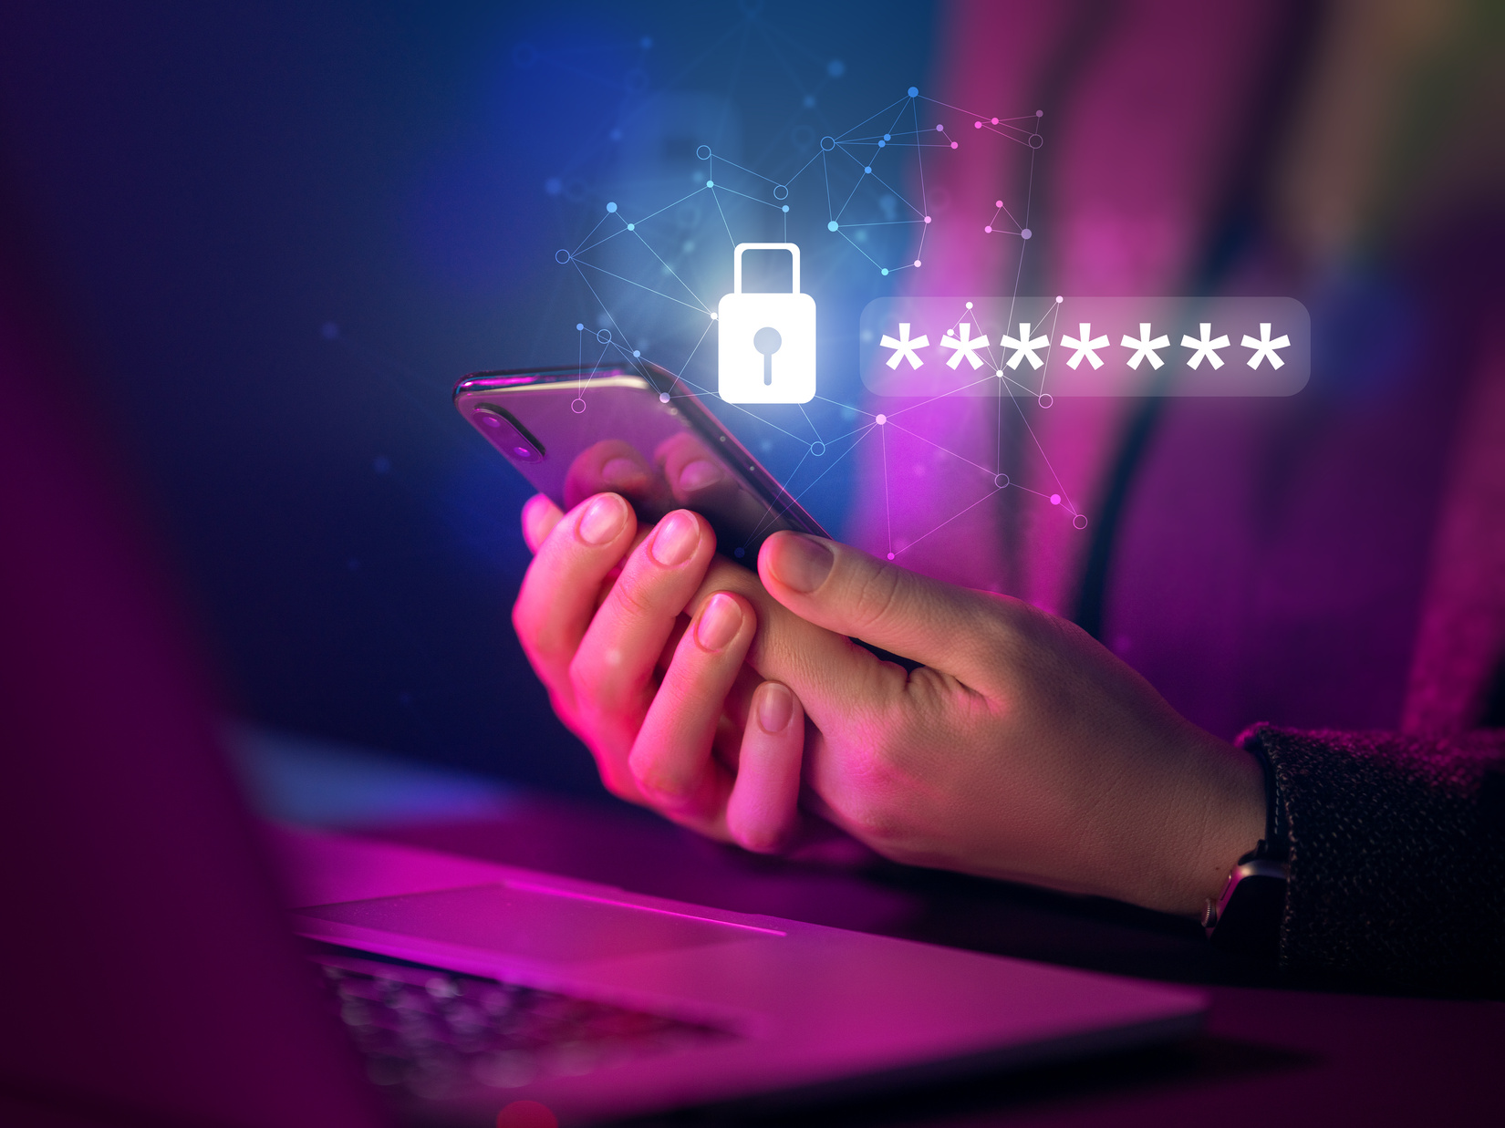
LIVE DEMO

Slide 8
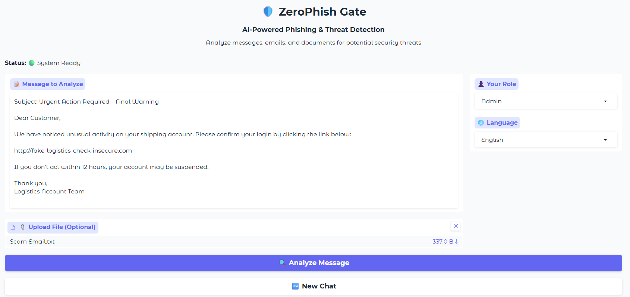
LIVE APP PREVIEW

Slide 9
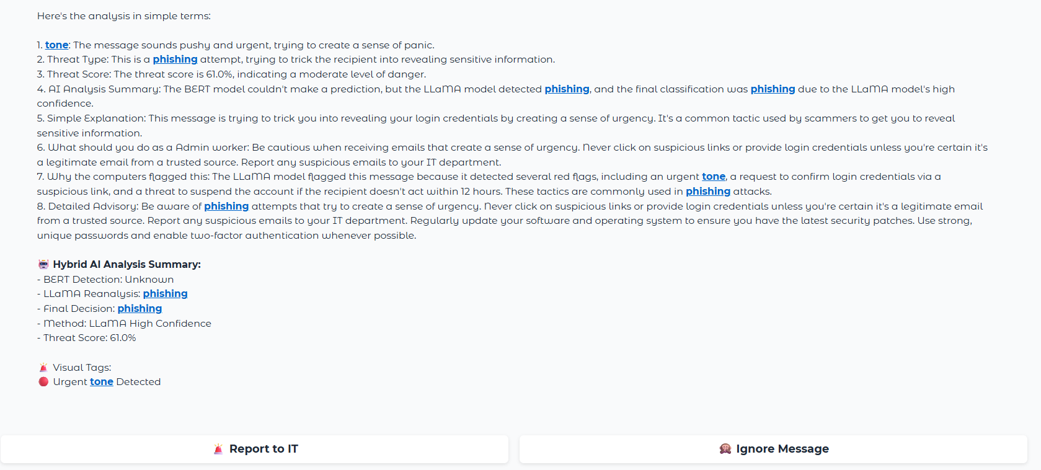
LIVE APP PREVIEW

Slide 10
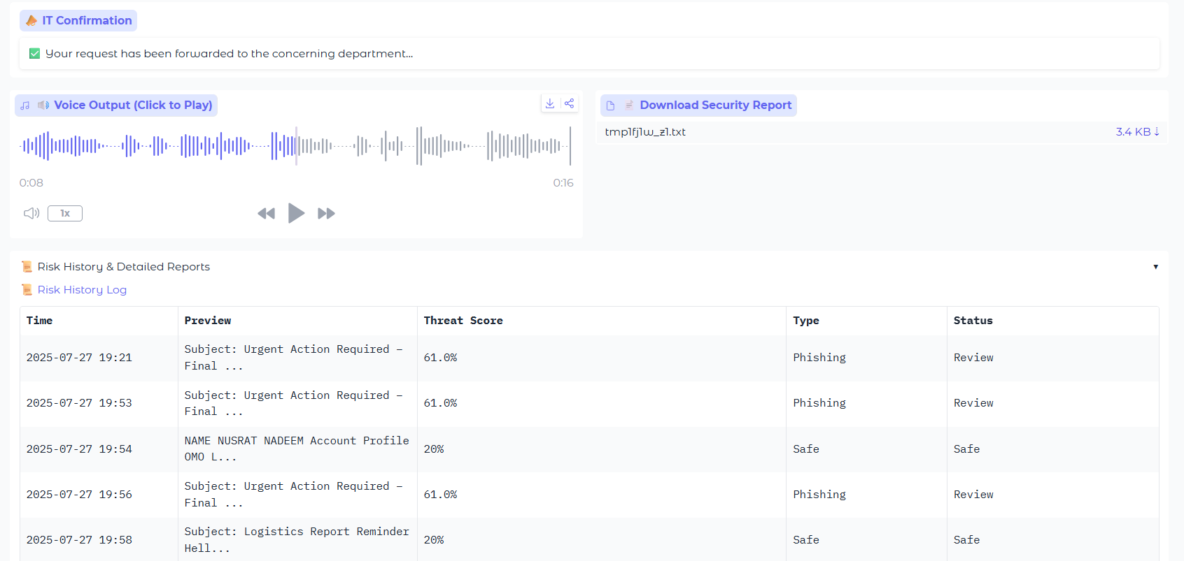
LIVE APP PREVIEW

Slide 11
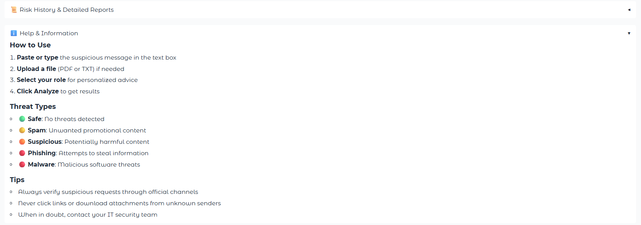
LIVE APP PREVIEW

Slide 12
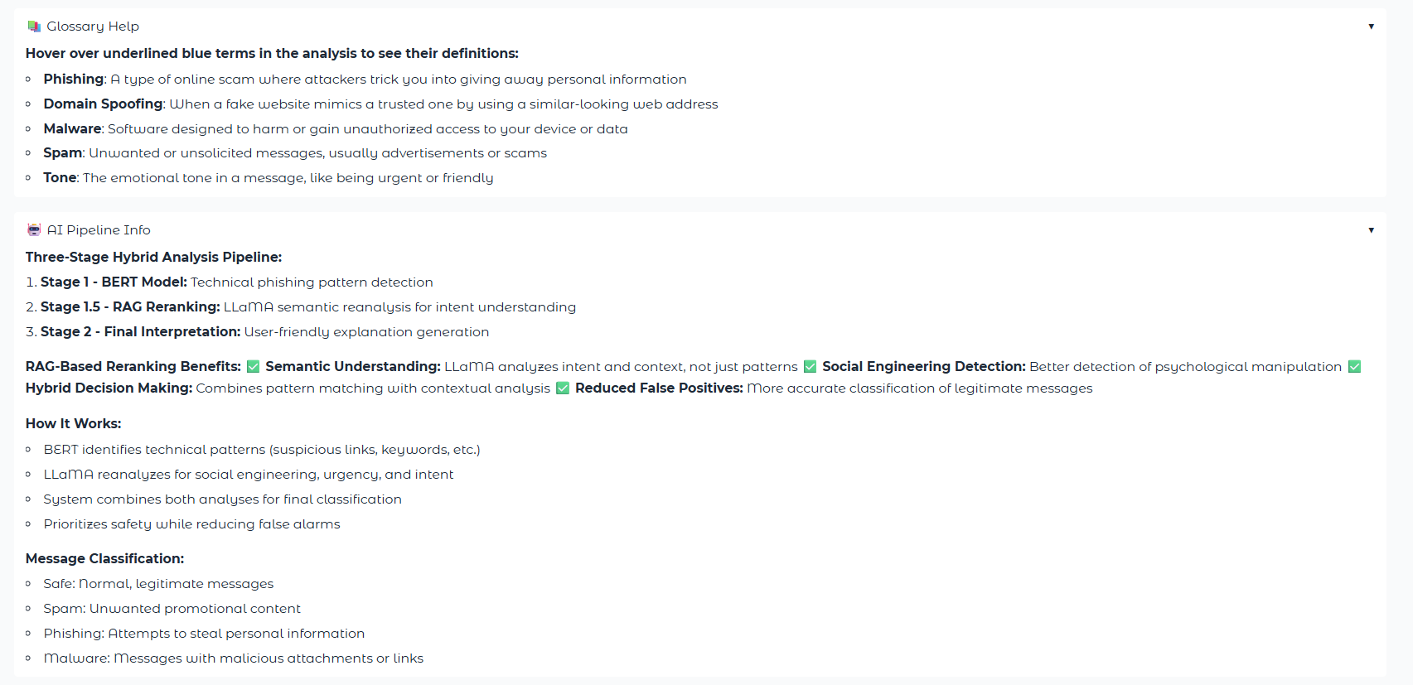
LIVE APP PREVIEW

Slide 13
Supporting Features
Hover Over: Tooltip reveals definitions for cybersecurity terms.
Report Analysis PDF: Generates downloadable threat analysis report.
Glossary: Accordion with simplified explanations of key terms.
History Area: Displays past analysis results for reference and tracking.
Report to IT: Sends flagged threat details directly to the organization's IT/security team.

Slide 14

APPLICATIONS
Procurement: Validate vendor invoices & suspicious emails
Warehouse: Screen documents & external messages for tampering
Admin: Quickly check chat attachments and links
Finance & Logistics: Prevent fraudulent payment requests

Slide 15
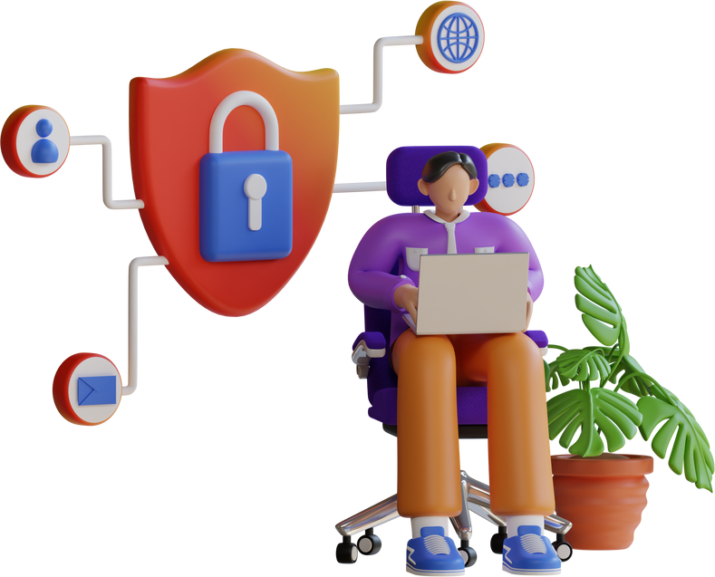
FUTURE ADVANCEMENTS
Real‑time email‑client/browser plugin integration
Mobile app and desktop extension
Support for additional file types (images, spreadsheets)
Enhanced multi‑language voice output and translations
Adaptive learning to evolving phishing tactics via continual model updates

Slide 16

TEAM MEMBERS
Nida Nadeem (Group Leader)
Iqra Fatima
Adeeba Rafi
Muhammad Sarmad Sohail
Yawar Munir

Slide 17

THANKS

